Slide 1










Bioanalytical Tools – Emerging technology to assess the impact of environmental contaminants
Alvina Mehinto
Southern California Coastal Water Research Project

Slide 2

Monitoring for CECs is a moving target
Current monitoring focuses on a small portion of known chemicals
  No mechanism to address unexpected chemicals
Relevant toxicity data is limited
  Mixture effects is of concern
Prioritizing CECs and establishing
relevant monitoring thresholds
can be difficult
DDTs
PFASs
Pyrethroids

Slide 3
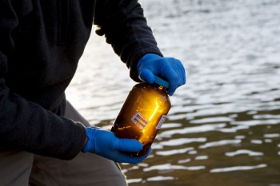
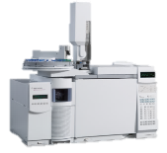
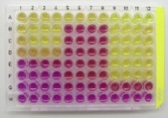
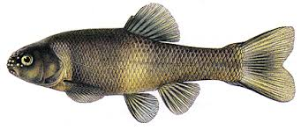
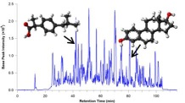
Effects-based monitoring as an alternative
Tiered framework to:
Supplement chemical-by-chemical monitoring
Improve understanding of mixture toxicity
Endorsed by California State Water Board
Bioanalytical cell assay
Which chemicals should be prioritized?
Targeted chemistry
Which toxicity pathways are of concern?
Non-targeted chemistry
Lab (animal) toxicity test
Field survey

Slide 4
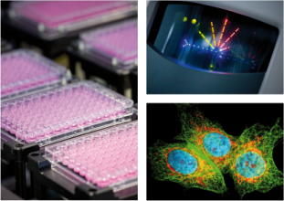
Cell bioassays - background
Rapid, cost effective method to screen for multiple chemicals simultaneously
Engineered to represent key biological pathway
  i.e. potential link to adverse effect
Combined measure of all chemicals with same biological activity
Currently used by pharmaceutical, cosmetic and food industries; and for chemical registration by USEPA

Slide 5
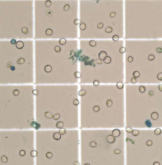
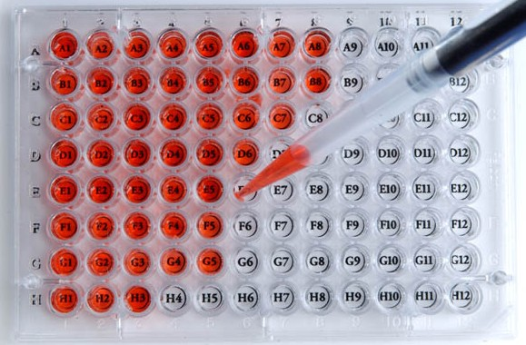
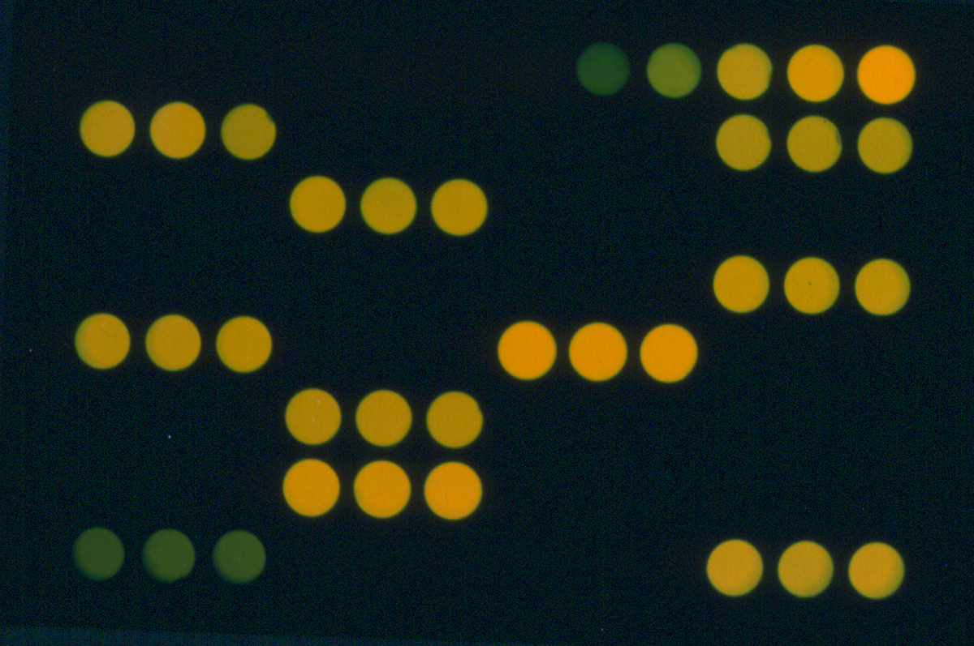
Cell bioassays- Mechanism
Mammalian cells engineered to track cellular responses
Cells and sample extracts are added to each well, and incubates
Light intensity is proportional to the concentration of bioactive chemicals
Results expressed as equivalent concentration relative to a known chemical

Slide 6
Candidate cell bioassay endpoints
Bioassays | Associated toxicity | Known chemicals
Estrogen receptor alpha (ERα) | Feminization, impaired reproduction | Estrogens, alkylphenols
Aryl hydrocarbon receptor (AhR) | Developmental anomalies, tumors | Dioxin-like compounds, PCBs, PAHs
Glucocorticoid receptor (GR) | Impaired immune functions | Anti-inflammatory steroids
Peroxisome proliferated-activated receptor (PPAR) | Metabolic disorders | Pharmaceuticals, phthalates

Slide 7
Cell bioassays for environmental monitoring
Goal is to develop a comprehensive set of cell bioassays
Widely available
Robust protocols with performance
based acceptance criteria
  Consistent with monitoring goals
Monitoring trigger levels
Endocrine disrupting chemicals
Estrogen receptor alpha (ERα)
Glucocorticoid receptor (GR)
Anti-androgen receptor (anti-AR)
Carcinogenic chemicals
Aryl hydrocarbon receptor (AhR)
Tumor protein P53 response element (P53RE)
Immunosuppressants and neurotoxins
Thyroid receptor (TR)
Peroxisome prolif. activated receptor (PPAR)
Acetylcholine receptor (AchR)

Slide 8
Key research questions
What is the sensitivity of cell bioassays?
  Can they discriminate between “clean” and contaminated samples?
Do bioactivity patterns make sense?
  Are cell bioassay data in agreement with other lines of evidence?

Slide 9
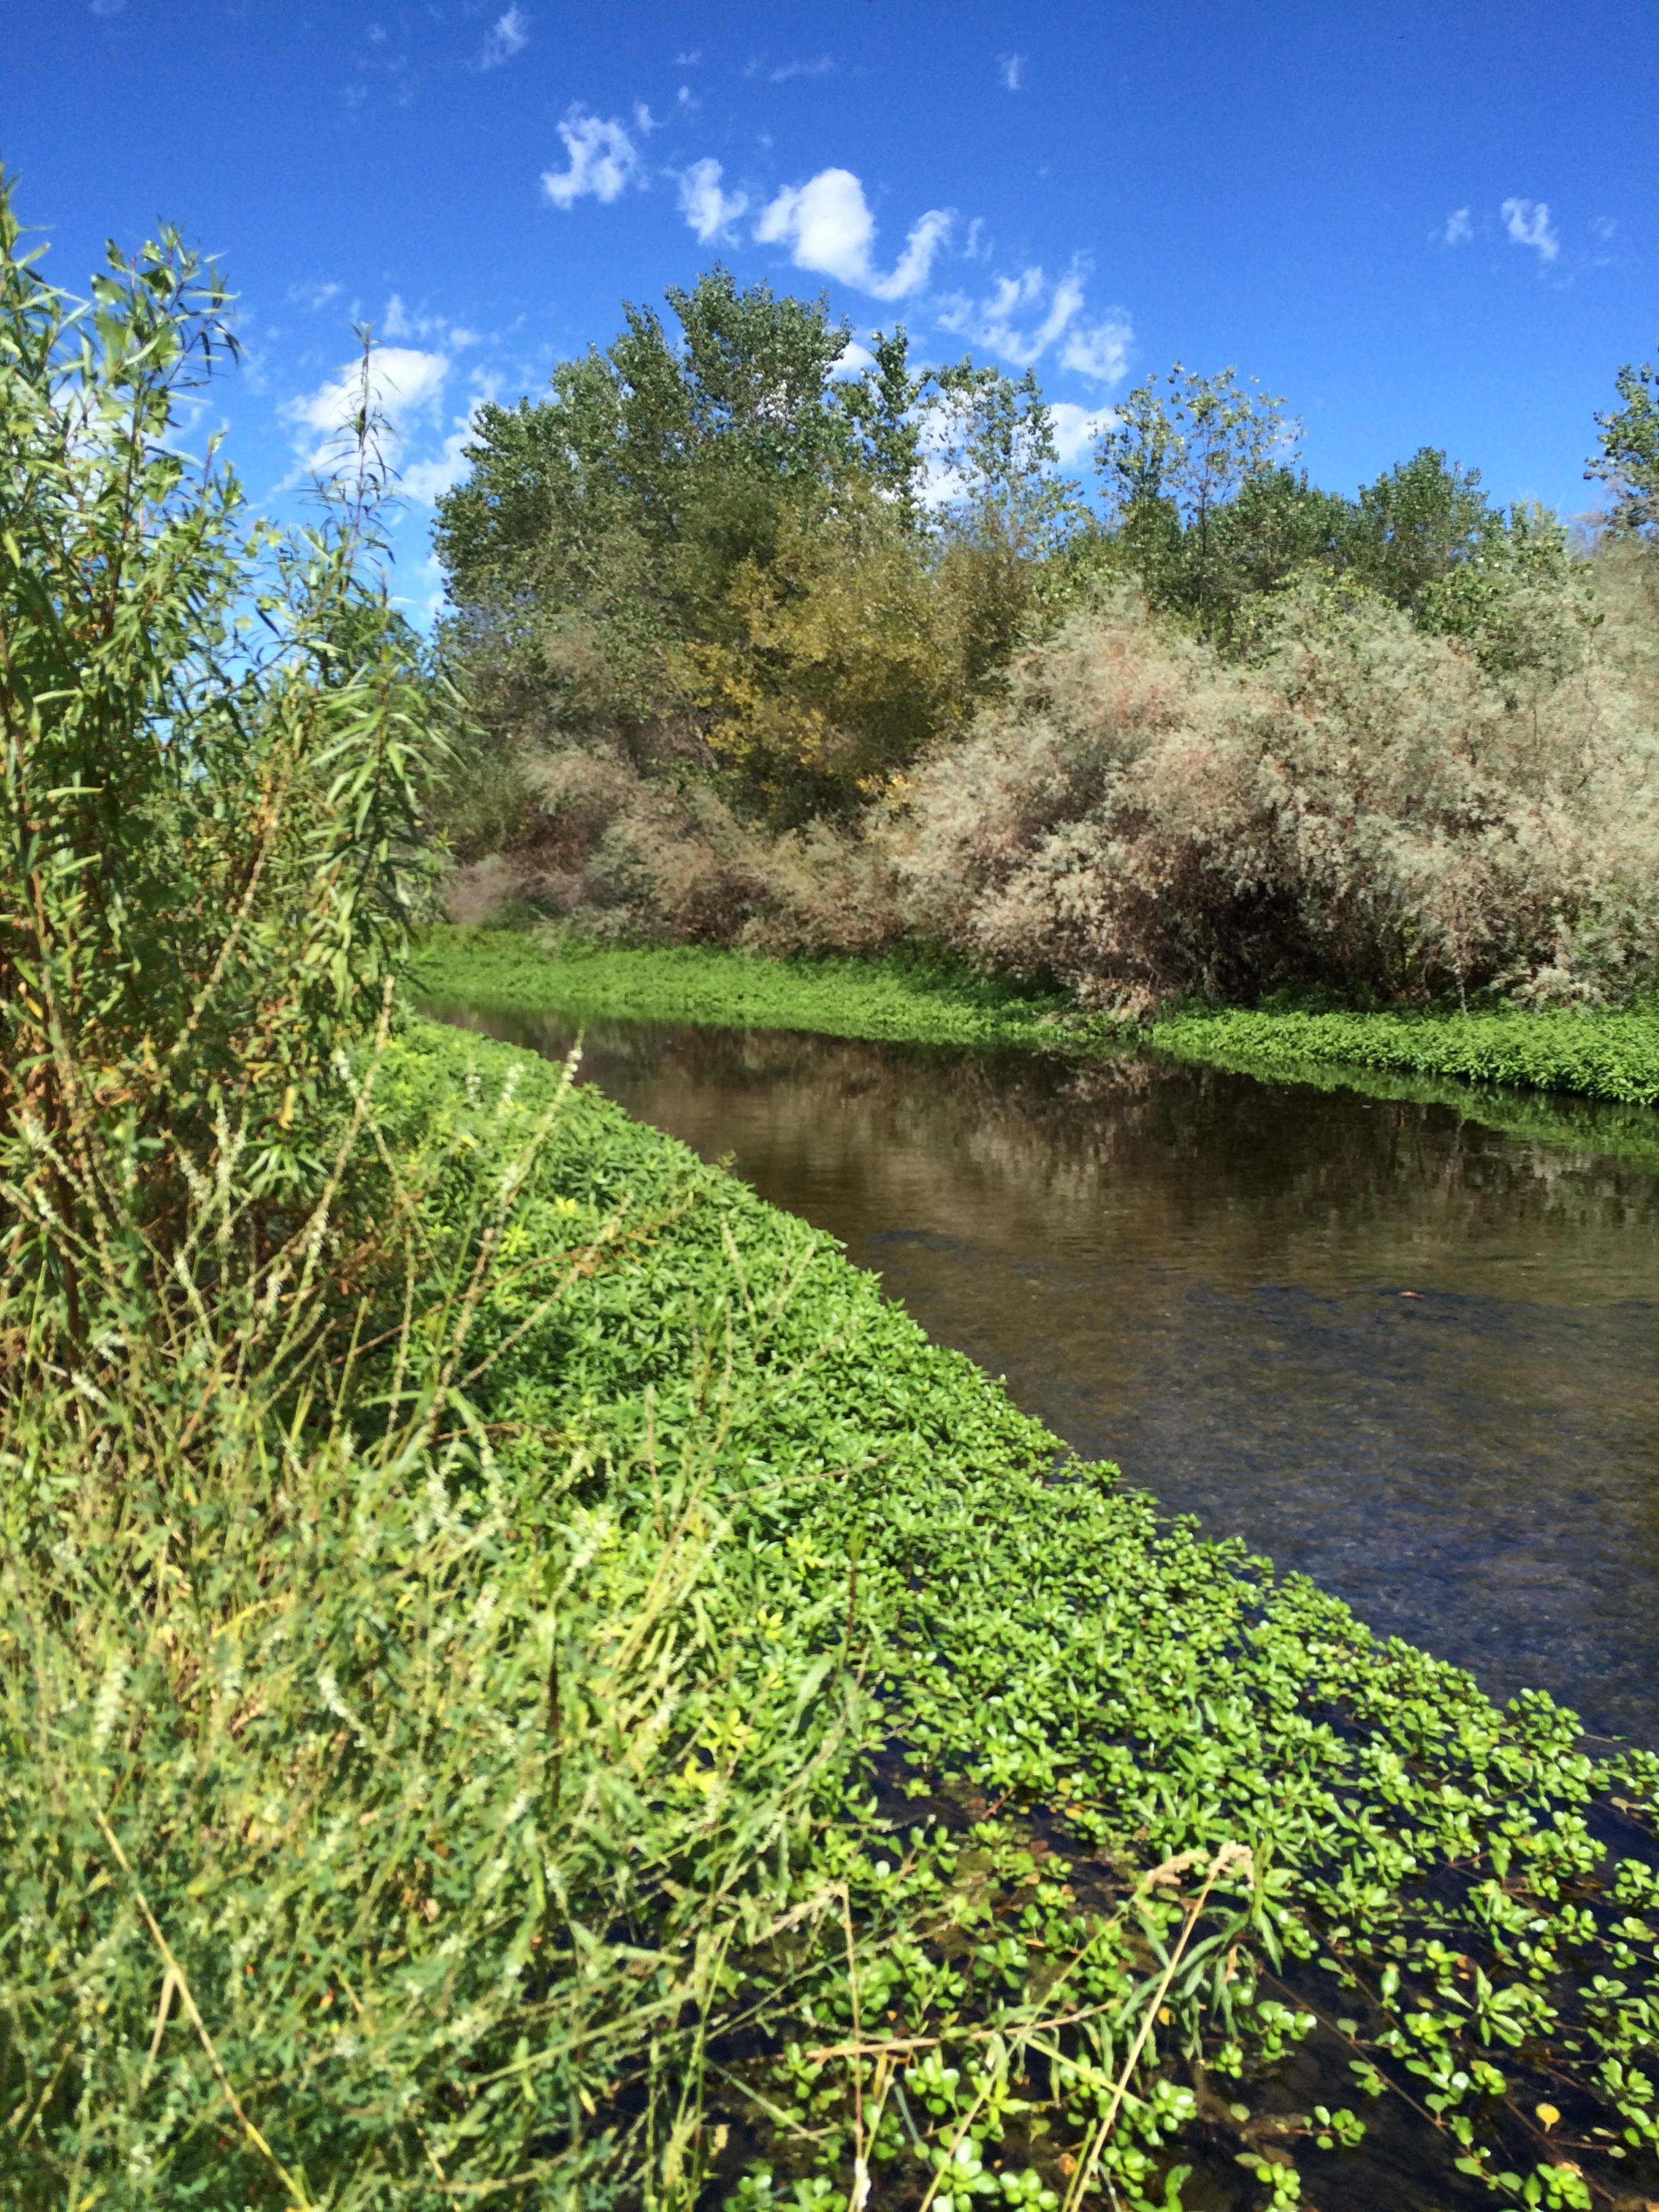
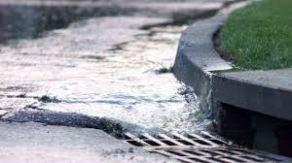
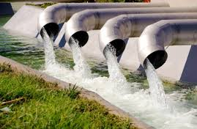

Our approach
Testing of various samples types
  Wastewater influents and effluents
  Ambient waters (stream, river, stormwater)
  Advanced treated water (microfiltration, reverse osmosis…)
  Sediment
Cell bioassay screening
  ERα, AhR, GR bioassays
Comparison with other lines of evidence
  Targeted, non-targeted chemistry data
  Lab toxicity data, biological indices

Slide 10
Bioscreening of effluent-impacted rivers
Samples from 8 wastewater treatment plants and ~30 sites in receiving waters throughout California
Bioactivity patterns reflected the level of treatment and concurred with available water quality data

Slide 11
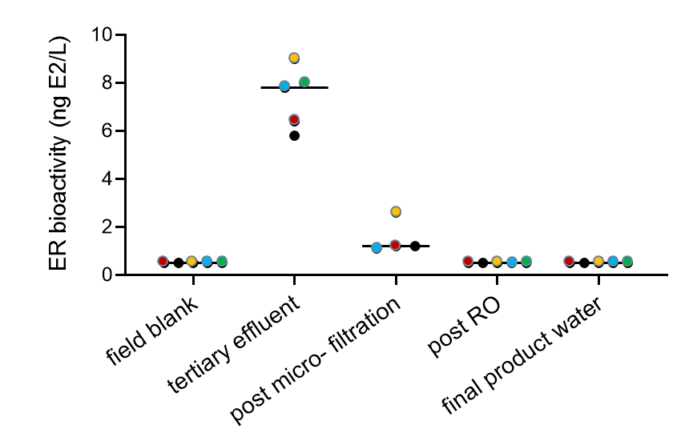
Reproducibility of results
We have participated in several intercomparison exercises
  Blind analyses of water sample extracts using commercially available assays
  Five laboratories with different level of expertise
  Data quality evaluated based on set of QA criteria (e.g. calibration, blanks, cytotoxicity)

Slide 12
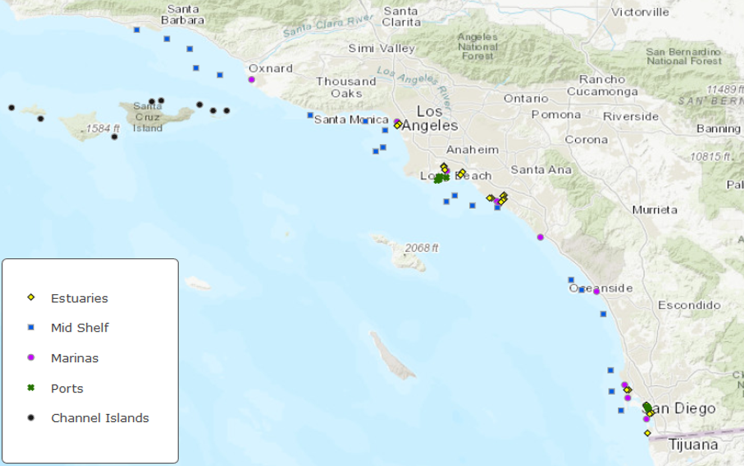
Bioscreening of coastal & marine sediment
Part of Bight 18 regional survey which aims to assess:
sediment quality
benthic communities
fish health and bioaccumulation
ocean acidification and algal toxins

Slide 13
Cell bioassay for site prioritization …
Study aimed to evaluate extent and magnitude of bioscreening responses
Highest AhR bioactivity levels were
found in estuaries
Only 1 sample from Channel Islands
had quantifiable AhR bioactivity

Slide 14
… and guiding further testing
Overall, good agreement between AhR bioactivities and ∑PAHs measured
Less so with toxicity data
But >75% of samples with no/low bioactivity were nontoxic
Differences in test sensitivity & endpoints could explain the discrepancies

Slide 15
Linking cell bioactivity to aquatic health
Area of ongoing research globally
  Understand the relationship between biological events at the cellular and whole organism levels
  Develop monitoring trigger values protective of aquatic life
We are using an Adverse Outcome Pathway concept
Chemical exposure
Cell receptor activity
Altered genes/ proteins levels
Tissue damage
Whole organism changes
lowest conc. for --> 10 × ? --> lowest conc. for
bioscreen response animal response

Slide 16
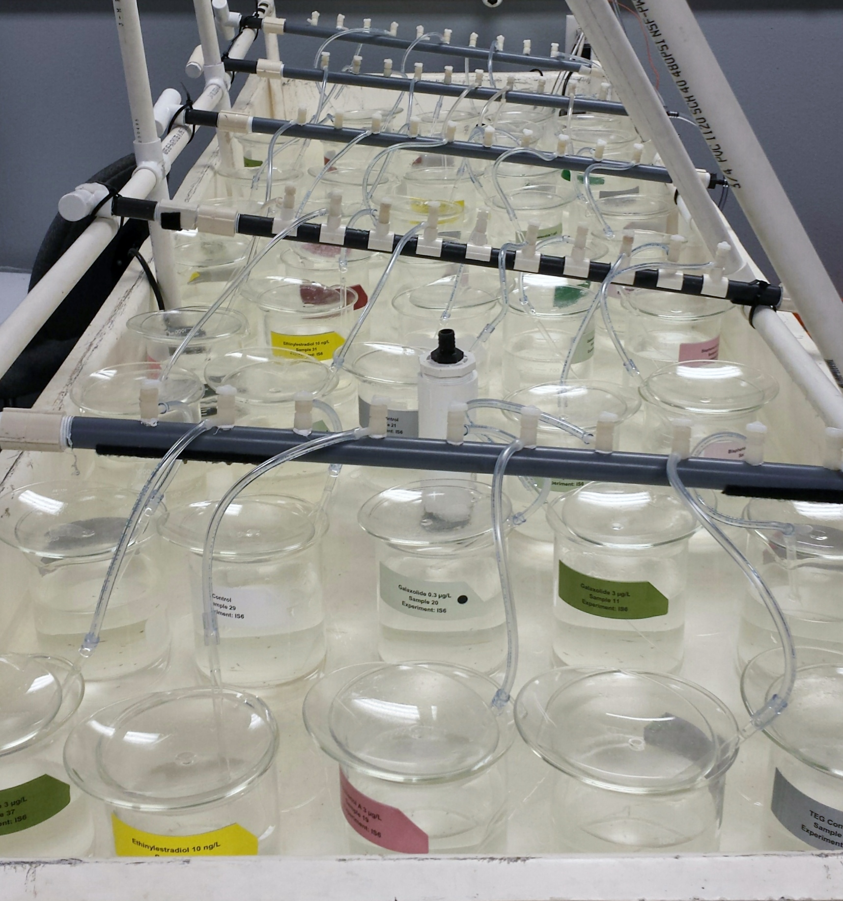
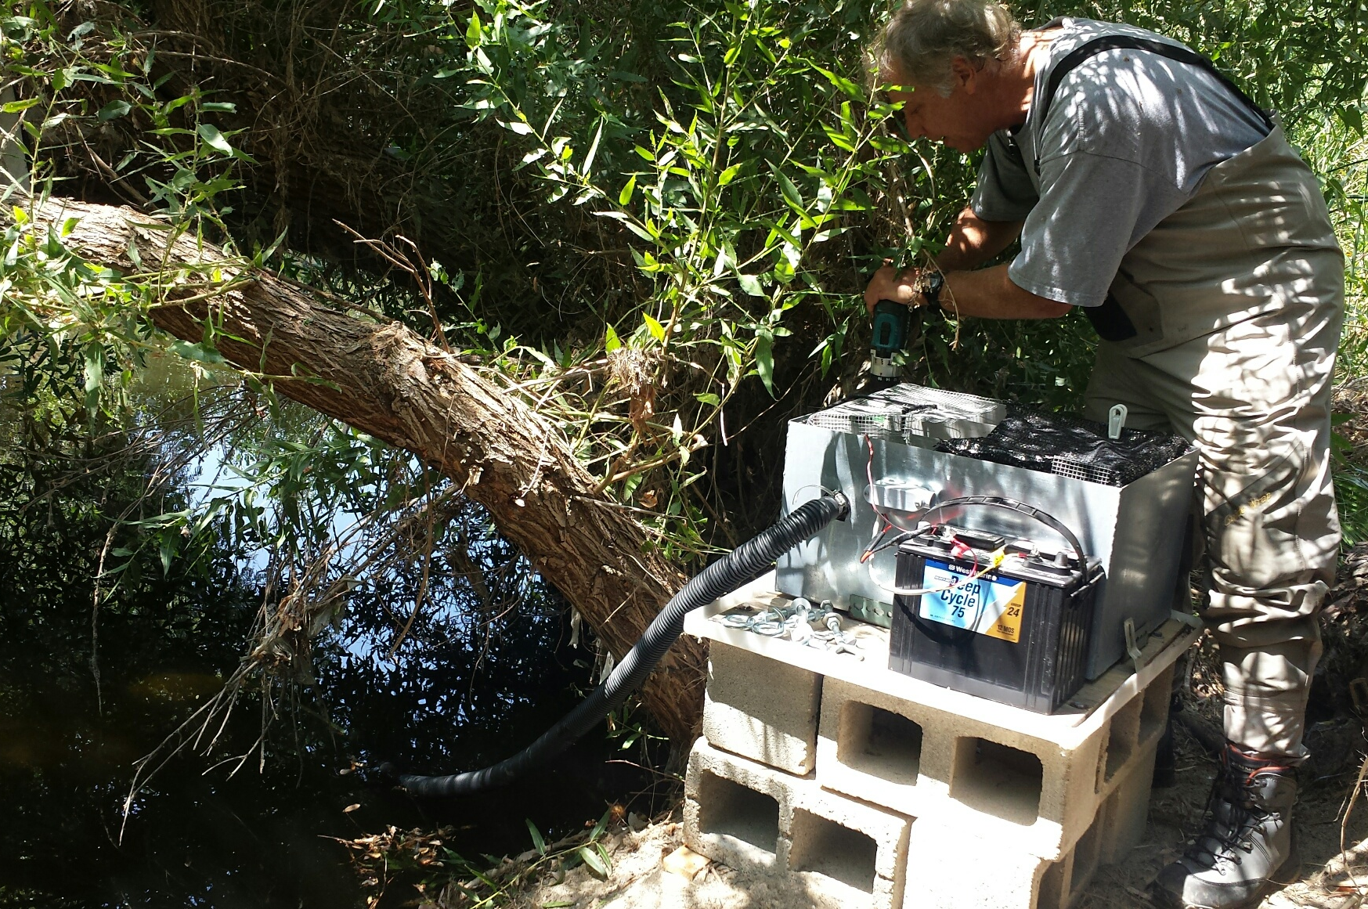
– Example –
In vitro / in vivo estrogenic responses
Exposures
  Lab-based: single chemicals and effluent dilutions
  Field-based: effluent impacted river
Biological models
  Fish: fathead minnows and Menidia silversides
  Cell assays: ERα GeneBlazer (LifeTech)
Endpoints
  Chemical conc. and bioactivity in water
  Gene/protein changes in fish tissues
  Development, reproduction, survival

Slide 17
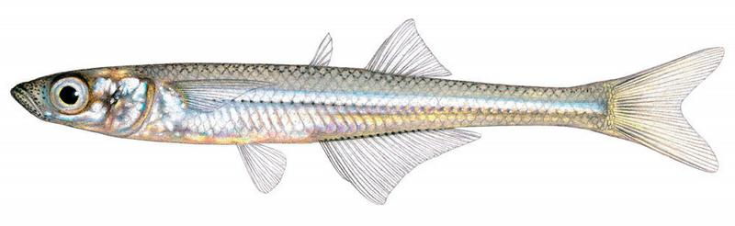
Using AOP knowledge to screen for toxicity
28-d exposure of juvenile silversides
Animal responses at conc. 5-25 x higher than cell assay responses
ERa bioactivity
Increased vtg/chg gene expression
Impaired gonad development
Reduced growth
EC₁₀ – 8 ng/L EC₁₀ - 16 ng/L BEQ <5 ng E2/L | 200 ng/L 100 ng/L No increase | 200 ng/L 300 ng/L No effect observed | > 500 ng/L > 300 ng/L No effect observed
E2
E1
Effluent dilution

Slide 18
Using AOP knowledge to screen for toxicity
21-d exposure of adult fathead minnows
Animal responses at conc. conc. 2 x higher than cell assay responses
Studies confirm our hypotheses that cell bioassays could serve as protective screen for toxicity
ERa bioactivity
Increased vtg gene expression
Altered sex characteristics
Reduced reproduction
EC₁₀ – 8 ng/L BEQ <5 ng E2/L | 18 ng/L No increase | 54 ng/L No effect observed | 180 ng/L No effect observed
E2
Receiving water

Slide 19
Lessons learned
Adapting cell bioassay for environmental monitoring is possible
  Capable of discriminating among water qualities
  Standardized protocols available for reproducible results
Effects-based monitoring could streamline existing practices
  Prioritization of sites requirement further testing
  Improved toxicity assessment of chemical mixtures
Establishing in vitro effect thresholds protective of aquatic life is possible

Slide 20
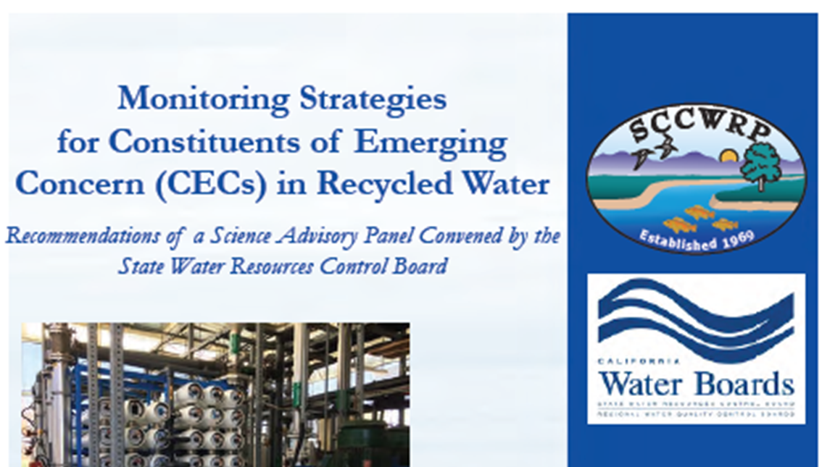
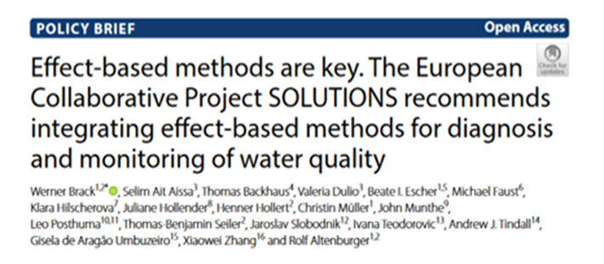
Towards application of cell bioassays
International experts have recommended the use of cell bioassays for water quality monitoring
First application focuses on diagnosis/prioritization of chemicals of concern

Slide 21
Questions?
Questions?
Alvina Mehinto
Principal Scientist in Ecotoxicology
(714) 755- 3210
alvinam@sccwrp.org

